Slide 1
Global Justice! Critical thinking of global power relations.
Economic growth

Slide 2
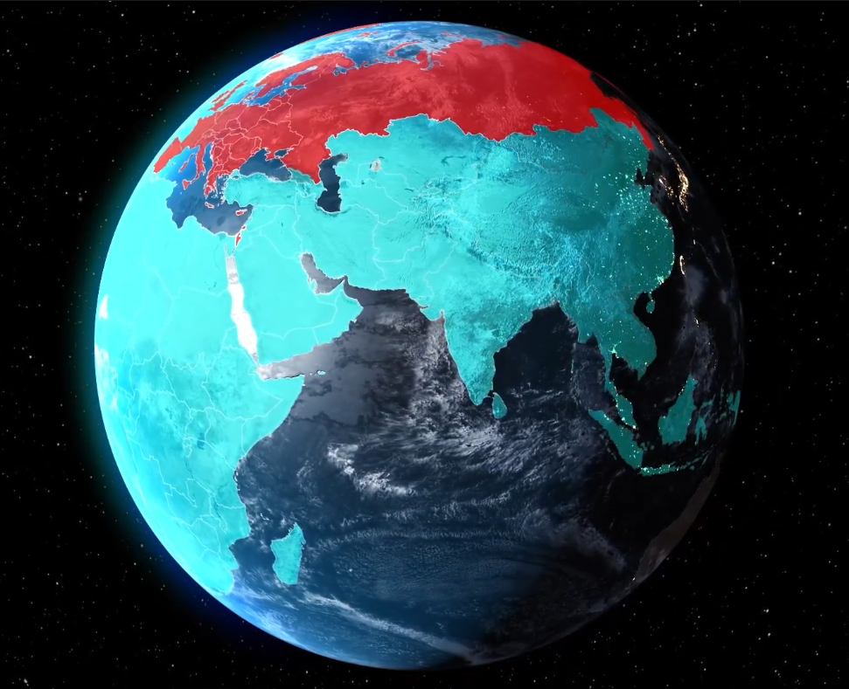
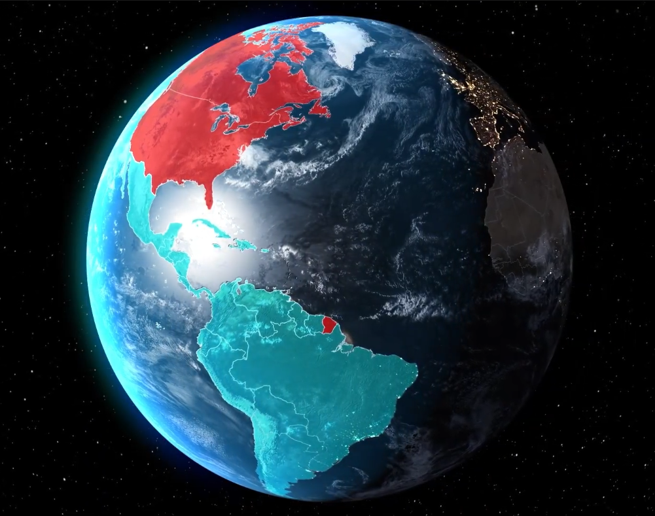
„Global North and Global South“

Slide 3
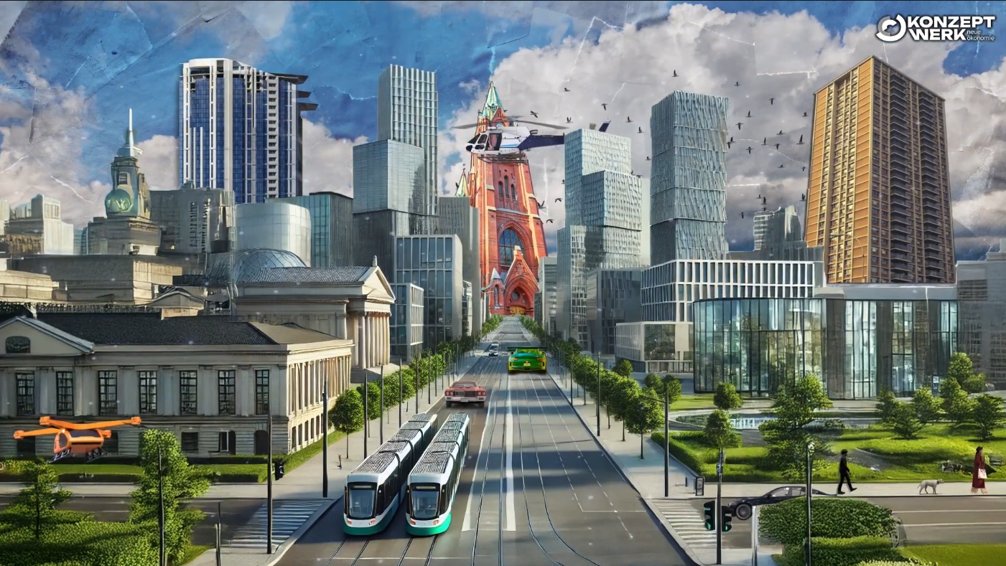
„Imperial mode of living“

Slide 4
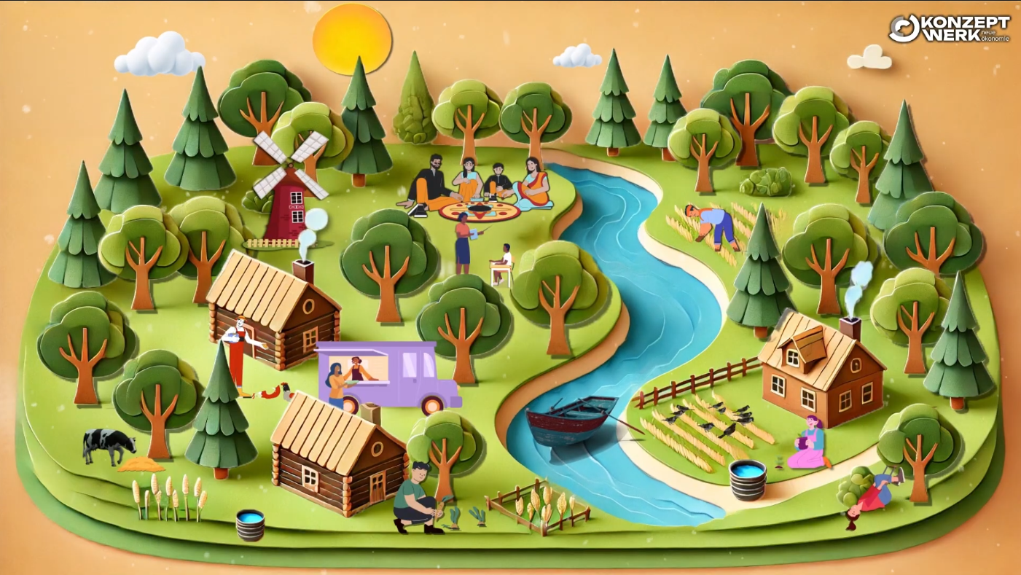
„Solidary mode of living“

Slide 5
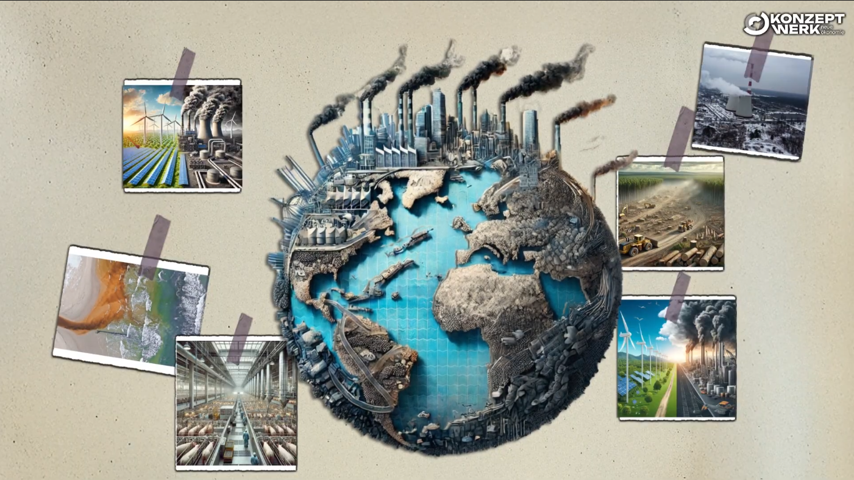
„Racism“

Slide 6
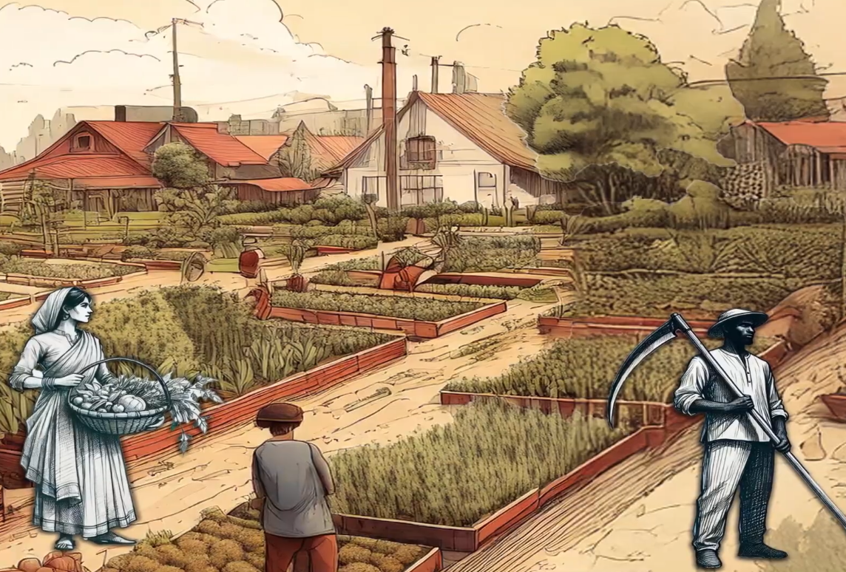
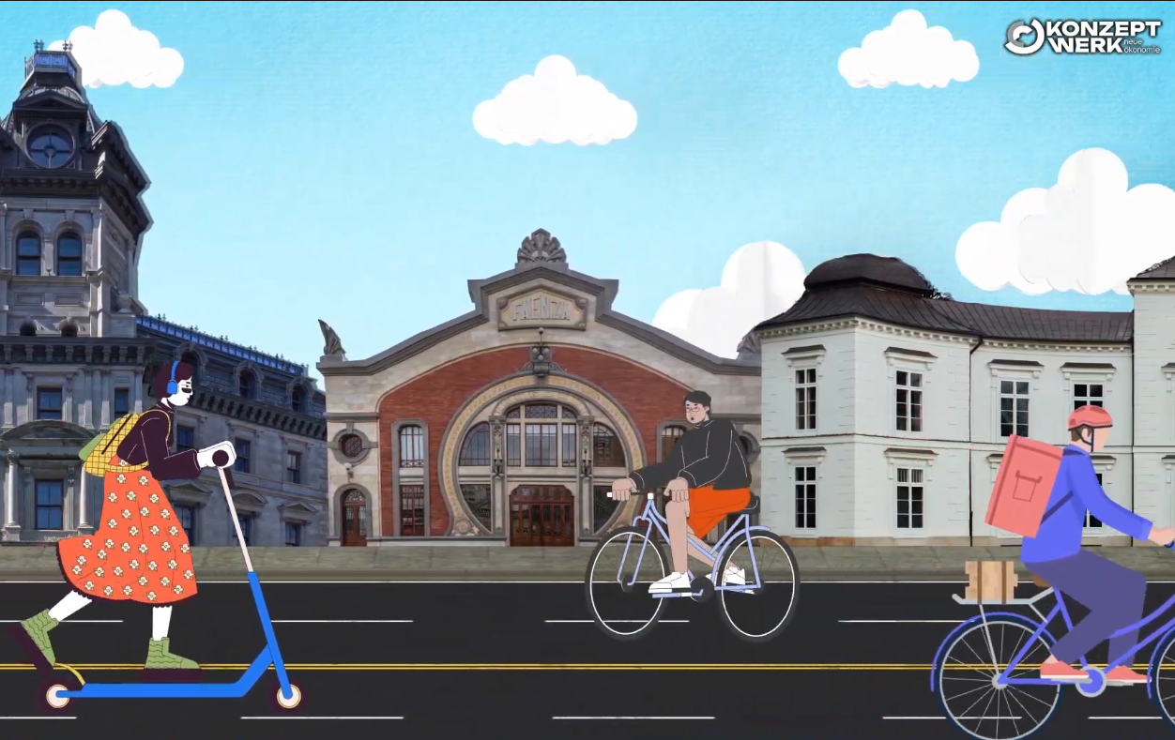
„Global Justice“

